Slide 1
Introduction to Protein Interaction Quantitation (PIQ)
March 13th, 2017
Notes:
.

Slide 2
TF footprinting
DNase I cleave DNA in regions of accessible, or hypersensitive chromatin.
DNase I cleavage is hindered by DNA-bound proteins such as TFs, leading to the creation of “DNase footprints”
After deep sequencing of DNase I–digested genomic DNA, genome-wide data on chromatin accessibility as well as TF-specific DNase I protection profiles are obtained.
TF signature ‘DNase profiles’ reflect the effect of the TF on DNA shape and local chromatin architecture.

Slide 3
Protein Interaction Quantitation
Two approaches :
De novo motif detection : detecting footprints and subsequently matching them to underlying motifs
Motif-centered searching : beginning with potentially bound motifs and subsequently determining whether each site has a footprint
PIQ uses motif-centered searching which can take into account each TF’s unique signature DNase profile information to improve individual binding prediction.
PIQ integrates prior information, such as the quality of a motif match, so that the method behaves robustly even with weak motifs or low-coverage data.

Slide 4
Protein Interaction Quantitation
The input for PIQ is DNase-seq data and a list of motifs represented as position weight matrices (PWMs) that describe candidate TF binding sites.
The output of PIQ is the probability of occupancy for each candidate binding site in the genome.

Slide 5
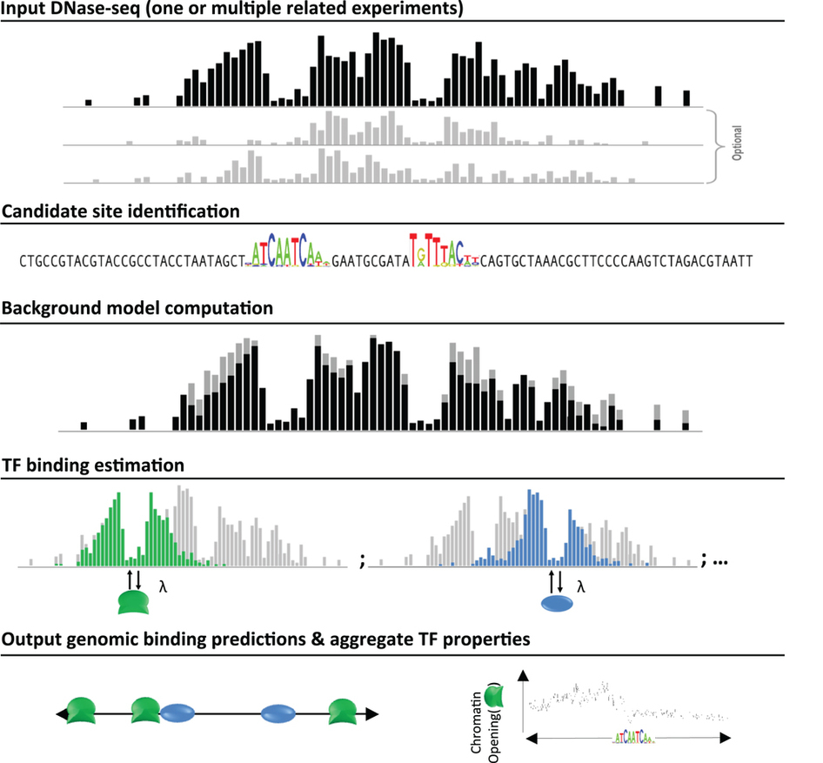

Slide 6
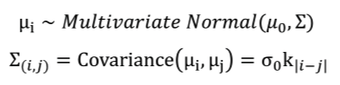
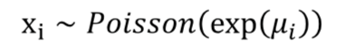
Step 1: computation of a background model, no factor binding case
PIQ models raw DNase-seq reads as arising from a Gaussian process, which is a statistical model that removes noise by adaptively smoothing the reads from neighboring bases.
μ_{i} : log-read rate per base
μ₀ : average log-read rate per base, a vector of length N with identical entries
σ₀ : marginal deviation in log-read rates
k_{|i-j|} : the correlation between neighboring bases.
Given μ_{i} , the read per base x_{i} is distributed Poisson with log-rate equal to μ_{i}

Slide 7
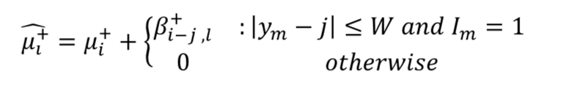
Step2 : identification of a candidate site and binding model
PIQ scans for DNase profiles at PWM motifs and find a binding site candidate m whose score passes some threshold.
y_{m} : base-pair representing the midpoint of such a motif match
I_{m} : indicator of whether the site is bound
β : DNase profile parameter representing TF’s effect on W base pairs around a motif match.
Binding-adjusted read rates for the + strand at a base i :

Slide 8
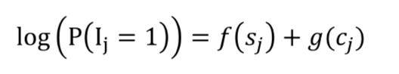
Prior model over binding indicators I_{m}
Encodes the requirement that binding events should occur more frequently as motif score and overall hypersensitivity increases.
Prior model for I_{j} :
f and g : arbitrary monotone functions
s_{j} : motif score for candidate j
c_{j} : total number of DNase counts within M base pairs
f and g are estimated to maximize marginal likelihood and are TF and experiment specific.

Slide 9
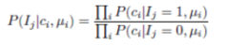
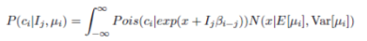
Step 3: estimation of TF binding
Estimate parameters μ₀, σ₀, k_{|i-j|}, β_{i-j,l} to maximize the likelihood of the observed reads C_{i}
Obtain posterior mean and variance of per base rates E(μ_{i}), Var(μ_{i})
Binding identity for a binding site is inferred via the likelihood ratio
where

Slide 10
Step 4. Constructing binary binding site calls
In order to match outputs with ChIP and DNase peak callers, use a straightforward t-test based cutoff to call sites as binary bound/unbound.
Use binding-rate (probability of binding times local chromatin accessibility) as the primary metric.
Fit a normal to the unbound portion using the median and interquartile range.
Cut off calls at 0.01 p-value and detect on average ten thousand binding sites per factor.

Slide 11
Mouse Jaspar Core Data
>MA0002.2 RUNX1
A [ 287 234 123 57 0 87 0 17 10 131 500 ]
C [ 496 485 1072 0 75 127 0 42 400 463 158 ]
G [ 696 467 149 7 1872 70 1987 1848 251 81 289 ]
T [ 521 814 656 1936 53 1716 13 93 1339 1325 1053 ]
>MA0004.1 Arnt
A [ 4 19 0 0 0 0 ]
C [16 0 20 0 0 0 ]
G [ 0 1 0 20 0 20 ]
T [ 0 0 0 0 20 0 ]
>MA0006.1 Ahr::Arnt
A [ 3 0 0 0 0 0 ]
C [ 8 0 23 0 0 0 ]
G [ 2 23 0 23 0 24 ]
T [11 1 1 1 24 0 ]
>MA0007.3 Ar
A [1094 939 8 1197 2167 4 1997 199 561 755 33 0 22 1195 7 32 430 ]
C [ 167 17 0 291 5 2189 20 1228 611 250 277 4 4 112 2166 1542 1092 ]
G [1555 2221 3837 184 3 5 273 328 991 1673 8 3618 0 230 0 2 343 ]
T [ 286 19 6 1027 3 2 11 712 509 207 2529 1 2768 1094 8 829 913 ]

Slide 12
output
chr10 16309083 16309098 MA01432 Sox2 967 +
chr10 16309136 16309151 MA01432 Sox2 1000 -
chr10 29720708 29720723 MA01432 Sox2 1000 -
chr10 57909312 57909327 MA01432 Sox2 1000 +
chr10 119363158 119363173 MA01432 Sox2 1000 +
chr11 96517000 96517015 MA01432 Sox2 964 +
chr11 102864523 102864538 MA01432 Sox2 1000 +
chr12 45472543 45472558 MA01432 Sox2 1000 -
chr12 100158630 100158645 MA01432 Sox2 916 +
chr12 114393961 114393976 MA01432 Sox2 902 +
Purity is a proxy for PPV. A purity of 0.7 means 70% of the entries will be bound.

Slide 13
Footprint enrichment test
Identify a TF that regulates a set of peaks
Test if the number of footprints of a specific TF overlapping with the peaks of interest (ex. distal alpha peaks) is significantly different from the number of footprints overlapping with another set of peaks (ex. non-differential distal peaks)
Usually, the two sets of peaks have different peak intensities, for example,
average peak intensity of distal alpha peaks (5412) =18
average peak intensity of non-differential distal peaks (19112) = 12

Slide 14
Number of footprints is proportional to the peak intensity

Slide 15
Distal alpha peaks (5412) vs. non-differential peaks (19112)
p1=number of times the TF overlaps one of distal alpha peaks per 1000 bp
p2=number of times the TF overlaps one of non-differential distal peaks per 1000 bp
q-value=testing difference of p1 and p2, multiple testing corrected

Slide 16
Distal alpha peaks (5412) vs. a subset of non-differential peaks (11690) whose average peak intensity = average peak intensity of distal alpha peaks
p1=number of times the TF overlaps one of distal alpha peaks per 1000 bp
p2=number of times the TF overlaps one of non-differential distal peaks per 1000 bp
q-value=testing difference of p1 and p2, multiple testing corrected

Slide 17
No. of genes under FDR 0.05 = 84
No. of genes under FDR 0.05 = 56

